Slide 1
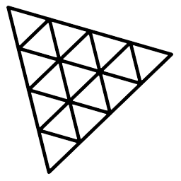
Three.js
3.JS
is
awesome
GUIDE FOR BEGINNERS
PROJECT PROPOSAL

Slide 2
TOPIC 11:
ABOUT
BUDGET
PROJECT
TIMELINE
MATERIALS
PROJECT PROPOSAL

Slide 3
WHAT IS MATERIAL
TABLE OF CONTENTS
INSTANTIATING A MATERIAL
PROPERTIES OF MATERIAL
What is Material
Instantiating a Material
Properties of Material
01
02
03
PROJECT PROPOSAL

Slide 4

WHAT IS MATERIAL
What is Material
Instantiating a Material
Properties of Material
01

Slide 5
What is Material
Instantiating a Material
Properties of Material
Materials in Three.js describe the appearance of objects. They are used to put a color on each visible pixel of the geometries.
The algorithms of the coding behind materails is written in shaders. Shaders are very difficult to write but in three.js we built-in materials with pre-made shaders.
Also we can create our own shaders but we will do that in future
There are many materials in THREE.JS like;

Slide 6
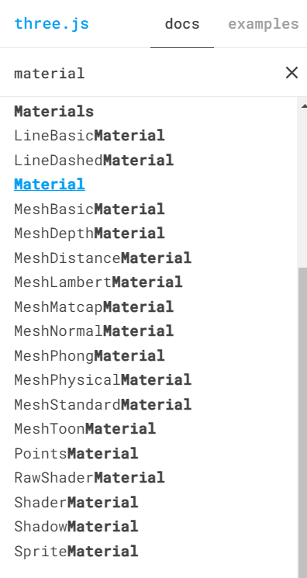
What is Material
Instantiating a Material
Properties of Material

Slide 7
What is Material
Instantiating a Material
Properties of Material
MeshBasic material: A material for drawing geometries in a simple shaded (flat or wireframe) way. This material is not affected by lights.
MeshStandard material: The approach in this material differs from older approaches in that instead of using approximations for the way in which light interacts with a surface, a physically correct model is used. The idea is that, instead of tweaking materials to look good under specific lighting, a material can be created that will react 'correctly' under all lighting scenarios.

Slide 8
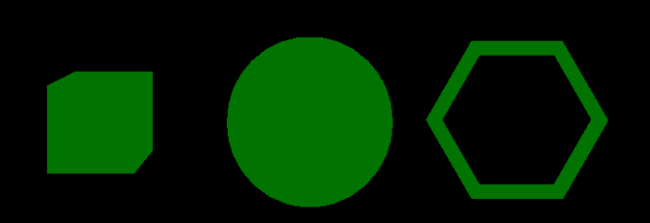
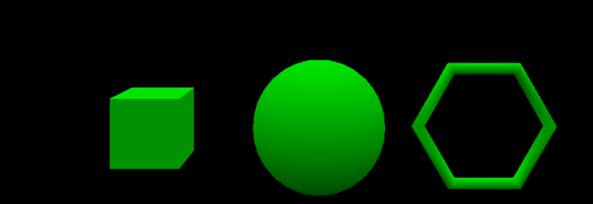
What is Material
Instantiating a Material
Properties of Material
MeshBasicMaterial
MeshStandardMaterial

Slide 9

Instantiating a Material
What is Material
Instantiating a Material
Properties of Material
02

Slide 10

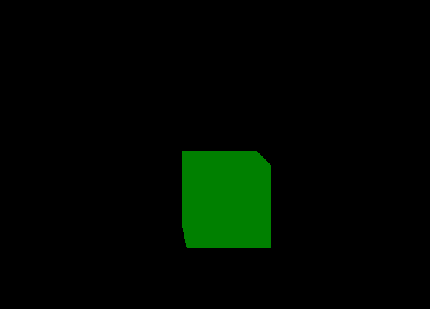
What is Material
Instantiating a Material
Properties of Material
Instantiating a material:
const cubeGeo=new THREE.BoxGeometry(1,1,1)
const cubeMat=new THREE.MeshBasicMaterial({})
const cube=new THREE.Mesh(cubeGeo, cubeMat)
cube.position.set(1,-2,1)
scene.add(cube)
const cubeGeo=new THREE.BoxGeometry(1,1,1)
const cubeMat=new THREE.MeshBasicMaterial({color:”green”})
const cube=new THREE.Mesh(cubeGeo, cubeMat)
cube.position.set(1,-2,1)
scene.add(cube)

Slide 11
Properties of Material
What is Material
Instantiating a Material
Properties of Material
03

Slide 12
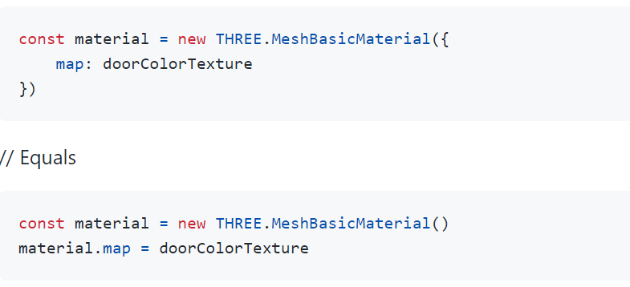
What is Material
Instantiating a Material
Properties of Material

Slide 13
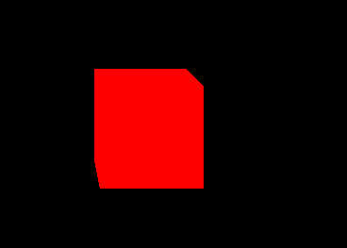
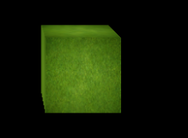
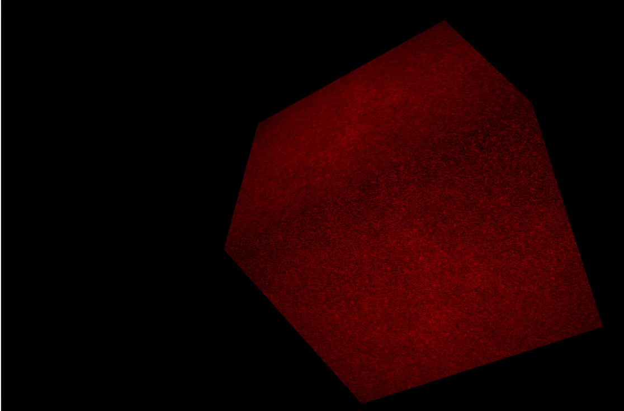
What is Material
Instantiating a Material
Properties of Material
COLOR:
const matGeo=new THREE.MeshBasicMaterial({
color:"#FF0000"
})
TEXTURE:
const matGeo=new THREE.MeshBasicMaterial(
{map:grassTexture}
)
Both COLOR AND TEXTURE:
const matGeo=new THREE.MeshBasicMaterial({
map:grassTexture,
color:"#ff0000"
}
)

Slide 14
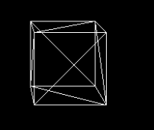

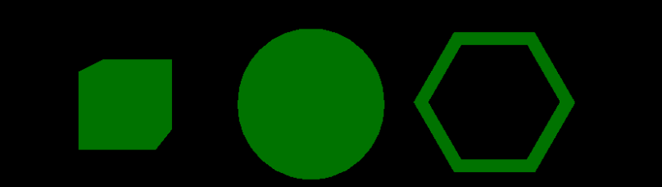
What is Material
Instantiating a Material
Properties of Material
WIREFRAME:
const matGeo=new THREE.MeshBasicMaterial({
wireframe:true
})
OPACITY:
const matGeo=new THREE.MeshBasicMaterial(
{map:grassTexture}
)
APPLY SAME MATERIAL ON MULTIPLE OBJS:
cube.material=matGeo;
sphere.material=matGeo;
torus.material=matGeo;

Slide 15
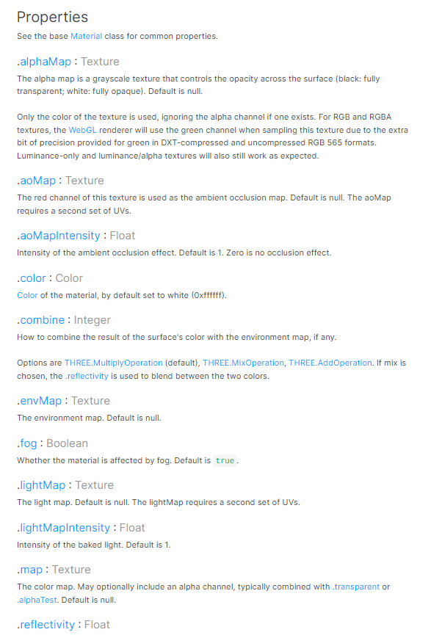
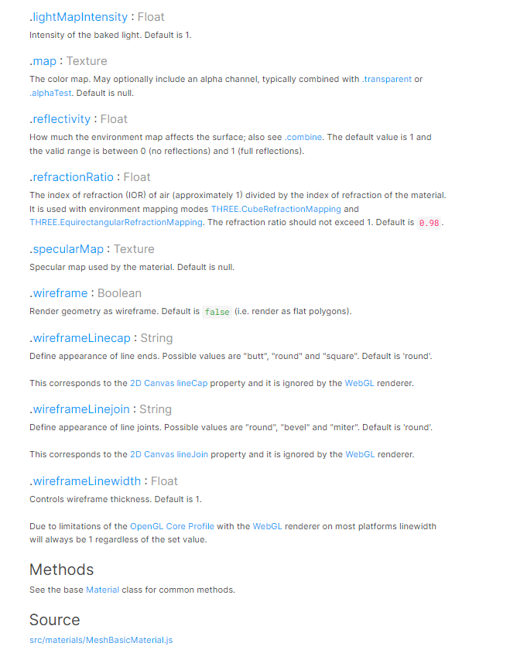
What is Material
Instantiating a Material
Properties of Material

Slide 16
THANKS!
ABOUT
BUDGET
PROJECT
TIMELINE
Do you have any questions?
EMAIL: aadnanshahh2001@gmail.com
GITHUB: https://github.com/AdnanShahSahb
Please keep this slide for attribution
PROJECT PROPOSAL

